Slide 1
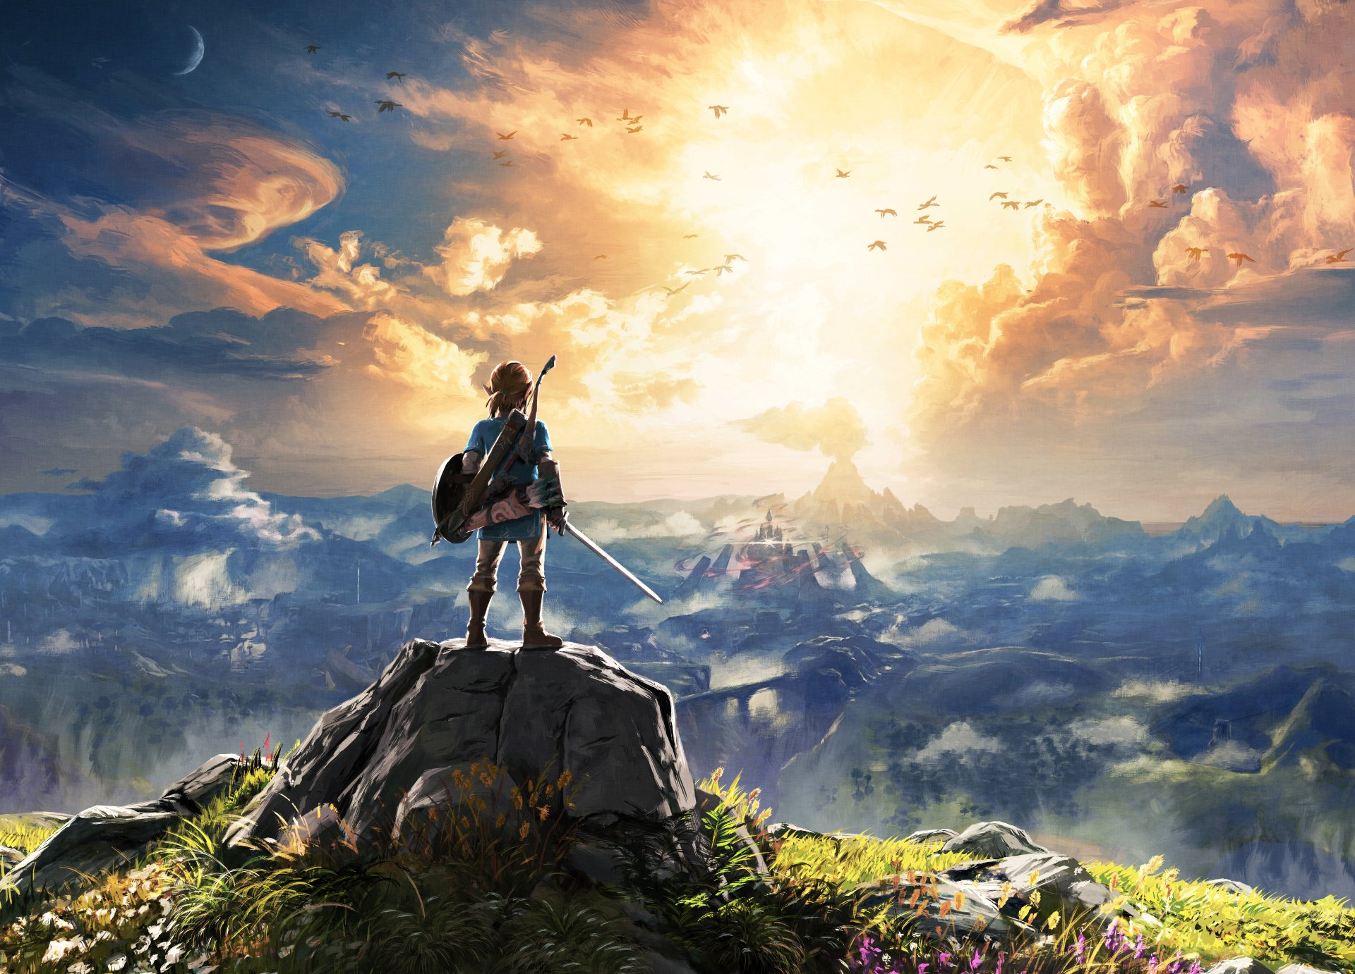
VIDEO GAME SALES
https://wall.alphacoders.com/big.php?i=789452
Notes:
https://wall.alphacoders.com/big.php?i=789452
As with many young kids, teenagers and more commonly nowadays, adults, I had spent a lot of my free time playing video games. To a lot of people who don’t play games, all they usually see are people just sitting around, wasting their lives away, distracted by some moving images on a screen. But to me, and to many gamers alike, video games are so much more than just small distractions. They provide a way for you to enter these amazing, immersive worlds that allow you to be more than just a spectator. They make it possible for you to interact with the environment and follow along in tear-jerking story lines. They get your heart racing and your veins pumping with adrenaline; they force you to face your fears and doubts; they fill you with this sense of adventure and wonder; leave you frustrated and fuming from a defeat; awestruck from the beauty of the vivid colors of the virtual world; grieve from the loss of a beloved character; and they can even allow you to know what it feels like to fall in love; video games make you feel alive.

Slide 2

Video Game Sales
Example of Street Fighter: “EVO Moment #37”
https://youtu.be/JzS96auqau0?t=5
Notes:
To get a brief glimpse of the world of video games, I wanted to share a short clip. I feel like you don’t have to play video games to appreciate what is going on in this clip and you can sense it from the reaction of the crowd. https://www.youtube.com/watch?v=JzS96auqau0

Slide 3

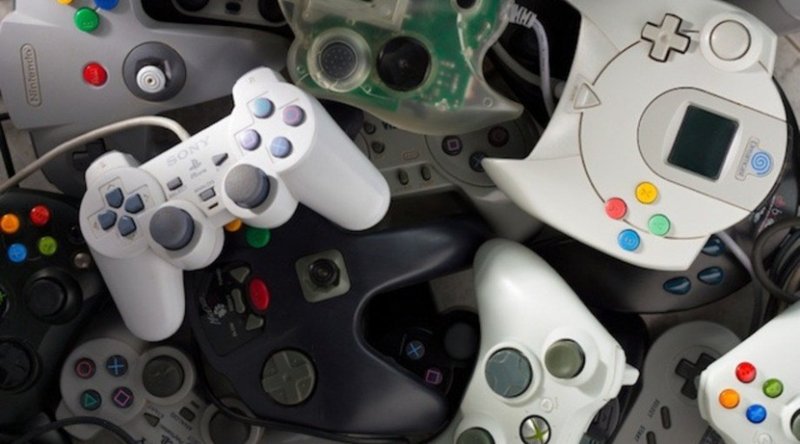
Video Game Sales
Multi-Billion Dollar Industry
http://thoughtforyourpenny.com/technology/video-games/10-best-gaming-podcasts-to-listen-to-in-2019/ https://oremc.com/o-raining-money-facebook#iLightbox[postimages]/0
Notes:
http://thoughtforyourpenny.com/technology/video-games/10-best-gaming-podcasts-to-listen-to-in-2019/
https://oremc.com/o-raining-money-facebook#iLightbox[postimages]/0
Now you may not know what exactly was happening in that clip, but what you do know is that it was awesome. The crowd yelling and cheering in excitement, everyone standing up and clapping, those were all real feelings and emotions that came from a video game.
The reason why I gave this introduction and showed you that video was because I am hoping that you understand my motivation for choosing this topic as the focus of my presentation and why so many people are passionate about video games and perhaps more relevantly (click), why it is a multi-billion dollar industry.

Slide 4


Racing to the Objectives
Observe relationship between video game scores and sales
Other features of a high selling video game
Machine learning model to identify high selling games
https://wccftech.com/review/onrush-beyond-finish-line/
https://www.flickr.com/photos/146274265@N03/46559151605/
Notes:
https://wccftech.com/review/onrush-beyond-finish-line/
https://www.flickr.com/photos/146274265@N03/46559151605/
Though I don’t get as much time nowadays to play, I am still passionate about the world of video games and I hope to provide some useful insights about what makes a game successful. Throughout this presentation we will explore some features (or variables) of video games and see how they are related to their sales.
It would be intuitive to think that video games that are highly scored should also perform well in sales, and many people would assume so. (click) We will take a look at this relationship and see how true this statement is. (click) We will also take a look at a few other features and see which ones produce the highest sales values. (click) and I would also like to present the results of using Machine Learning to create a predictive model that can classify a video game as being high selling or not.

Slide 5

The Dataset
https://www.kaggle.com/rush4ratio/video-game-sales-with-ratings
Notes:
Before we get too deep into the analysis and results, I would like to take some time to explain where the data came from and how it was prepared.
This dataset came from a Kaggle competition of video game sales and it contains some sales data for video games as well as their Metacritic scores.
https://www.kaggle.com/rush4ratio/video-game-sales-with-ratings

Slide 6
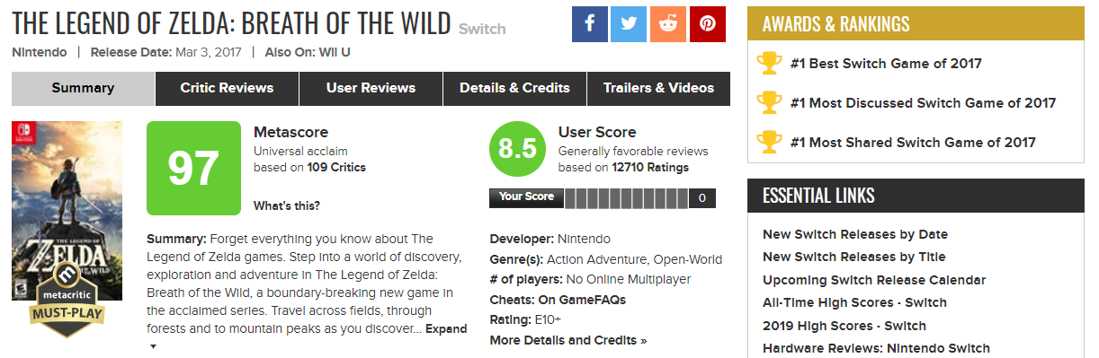
The Dataset
https://www.metacritic.com/game/switch/the-legend-of-zelda-breath-of-the-wild
Notes:
Metacritic is a popular multimedia entertainment review website that provides both a professional critic score and user score for video games and other media. https://www.metacritic.com/game/switch/the-legend-of-zelda-breath-of-the-wild. It is from these scores where we will observe trends in how they are related to how well a video game sells.

Slide 7
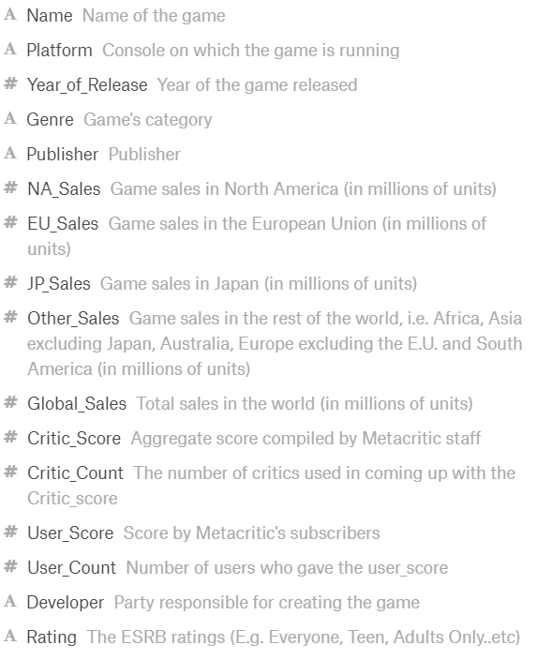
The Dataset
Problems
Duplicate video game names
Games that were not released yet
Did not have both Critic Score and User Score
Solutions
Group dataset by video game names
Video games before 2016
Only games with both Critic and User scores
Notes:
The original dataset contained features such as name, platform, sales for 3 different countries as well as overall, globally, etc. This dataset came in a relatively clean state but some problems needed to be dealt with in order to perform the analysis that we are looking for (click 1). Some of the problems were that some video games appeared more than once (click 2), the dataset contained video games that were not released yet at the time this dataset was made, which was 2016(click 3), and because we will be looking at the scores of a video game, some video games did not have both the critic score and the user score (click 4).
(click 6) The solutions that were taken in order to deal with these problems were: (click 7) The dataset was grouped by the video game names, (click 8) filtered by only video games that were released before 2016, (click 9) and dropped records that did not contain both critic score and user score.

Slide 8
The Dataset
Columns for analysis
Name
Year of Release
Genre
Publisher
Global Sales
Critic Score
User Score
Notes:
After cleaning and wrangling the dataset to transform it into a form that we can perform analysis on, the following columns or features were obtained: name, year of release, genre, publisher, global sales, critic score, user score.

Slide 9


Critic Score vs User Score
Are they different?
https://www.hawkinspersonnel.com/cheerful-business-people-showing-thumbs-up-isolated-on-white/
https://striveliving.ca/adults-services/strive-centre/group-of-people-showing-thumbs-up/
Notes:
https://www.hawkinspersonnel.com/cheerful-business-people-showing-thumbs-up-isolated-on-white/
https://striveliving.ca/adults-services/strive-centre/group-of-people-showing-thumbs-up/
Metacritic provides two different scores for a video game. The critic score comes from professional critics and the user score are from normal everyday gamers. The question that comes to mind is:. Are they different? Does one group tend to score higher than the other? Do they tend to score similarly? To see this a histogram of the scores were plotted.

Slide 10
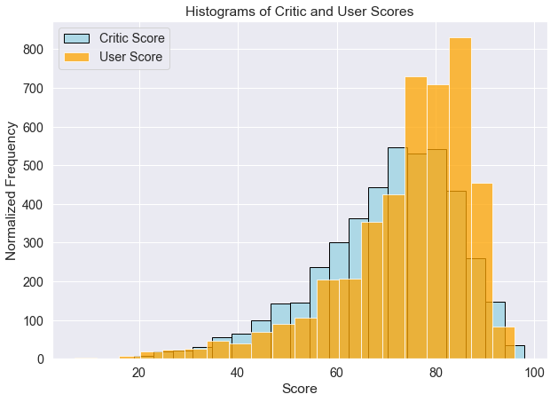
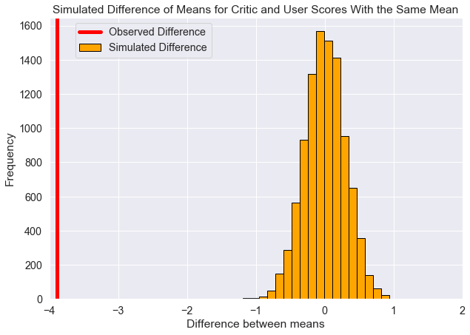
Critic Score vs User Score
Mean of Critic Score: 70.45
Mean of User Score: 74.34
Difference of means: 3.88
Bootstrap resampled a simulated dataset where mean of Critic score = mean of User score
Sampling distribution of difference of simulated means
P-value = 0.00… for observed difference
Notes:
This plot shows the critic scores in blue and the user scores on top in orange. On average, users tend to give video games higher scores than critics. But was this difference significant? (click) In order to visualize this a simulated dataset of the differences between bootstrap resampled critic scores and user scores where both of the means are similar had to be created (click). In this plot it can be seen that the observed difference of 3.88 way outside the range of the values from the simulated dataset. Therefore, if the means were the same, the chance that the observed value of 3.88 would have appeared is extremely low; and indeed this is seen from the practically 0 p-value. We now know that there is a statistically significant difference between critic scores and user scores. For this capstone project, we will focus on the critic score.

Slide 11
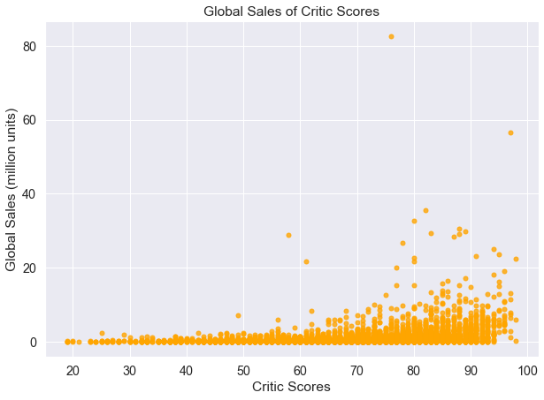
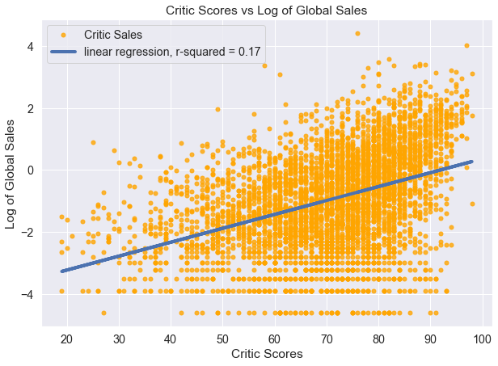
Critic Score and Global Sales
Scatter plot of Global Sales and Critic Scores
Majority of data points below 20 million units
Log transformation of Global Sales
Simple linear regression
R-squared value of 17%
Using Machine Learning to fit additional features
Produced new R-squared of 30%
Notes:
(click) Now, we will take a look at how the critic score of video games and how they affect the global sales. In this plot we can see that higher rated scores do tend to have slightly higher global sales. However, a majority of the data points are below the 20 million units sold mark, making it hard to visualize all of the data points. In order to create a better visualization, a log transformation was performed on the global sales values. (click) A simple linear regression line was fit to this scatter plot and an R-squared value of 17% was produced (click). Given that we are only looking at one of the features of a video game, the critic score, being able to explain about 17% of the variance in the log of global sales with this simple linear model is not bad.
But is there any way to increase this R-squared value? What can we do? (click) We could use machine learning!
By fitting a machine learning linear regression model on the rest of the features of a video game, the R-squared value was able to be increased by about 13%. We are now able to explain 30% of the variance in the log of global sales using the machine learning linear regression model.

Slide 12
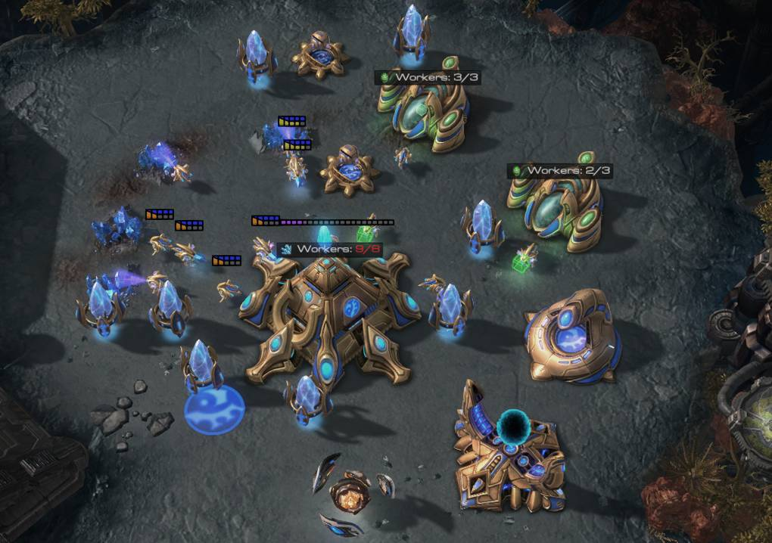


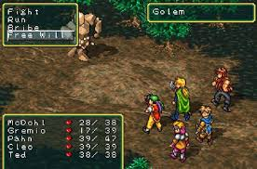



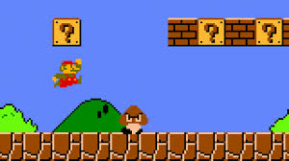


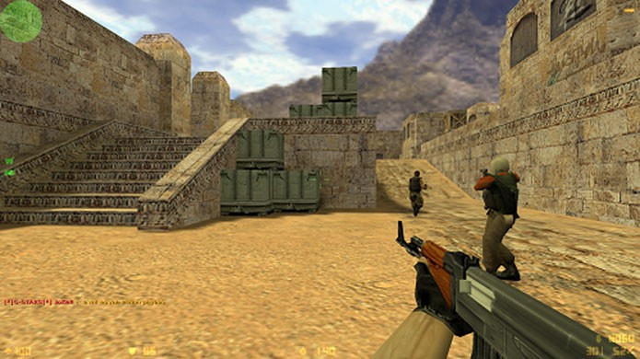
Video Game Genres
Strategy
Puzzle
Adventure
Action
Role-Playing
Simulator
Fighting
Racing
Platform
Sports
Misc
Shooter
**See notes for links to images
Notes:
One of the features of a video game is the genre. This dataset contained 12 different genre types that each video game can be classified under. We will be taking a look at how each genre performs in global sales.
https://www.wired.co.uk/article/deepmind-starcraft-results-alphastar - Strategy
https://variety.com/2016/film/news/tetris-movie-trilogy-1201805092/ - Puzzle
https://wall.alphacoders.com/big.php?i=789452 - adventure
https://www.techtimes.com/articles/95825/20151015/ea-wants-new-franchises-and-gigantic-action-games.htm - action
https://www.engadget.com/2012/04/12/the-delightful-smoothness-of-classic-japanese-role-playing-games/ - rpg
https://www.origin.com/usa/en-us/store/the-sims/the-sims-4/addon/the-sims-4-backyard-stuff - simulator
https://www.playstation.com/en-gb/games/street-fighter-v-ps4/ - fighting
https://www.twilio.com/blog/2017/04/making-super-mario-bros-even-more-difficult-for-science.html - platform
https://www.mmoga.com/EA-Games/FIFA-16.html - sports
https://www.ranker.com/list/rise-and-fall-of-guitar-hero/jordan-breeding - misc
https://www.techtudo.com.br/dicas-e-tutoriais/noticia/2015/03/counter-strike-16-confira-os-codigos-de-macetes-para-o-jogo-de-tiro.html - shooters

Slide 13
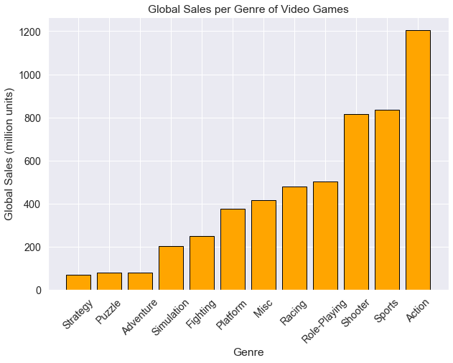
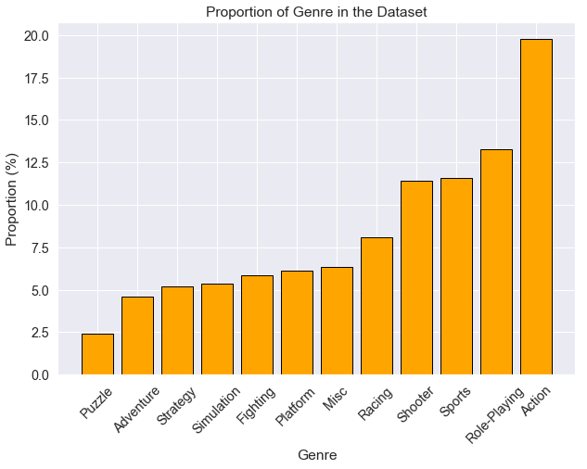
Genre vs Global Sales
Total global sales per Genre
Action games have the highest total global sales
About 400 million units higher than Shooters or Sports.
20% of all video games were action
More action games = more total sales
What is a better way to see genre and global sales?
Look at average sales!
Notes:
By grouping the video games by their genres and totaling up the global sales, it can be seen that Action games sell significantly more than any other genre. They outperform the next two highest selling genres by about 400 million units. Problem solved, just make action games and you’re good to go! (Not really) However, what was less apparent was that the main reason (click) for why action games had such high global sales was because within this dataset, (click) 20% of all the video games were action. If more of the dataset was of one genre, then that one genre should have the higher global sales value. So, what would be a better way to look at how well each genre performed in global sales? The Average! We would need to look at the average sales instead of total sales.

Slide 14
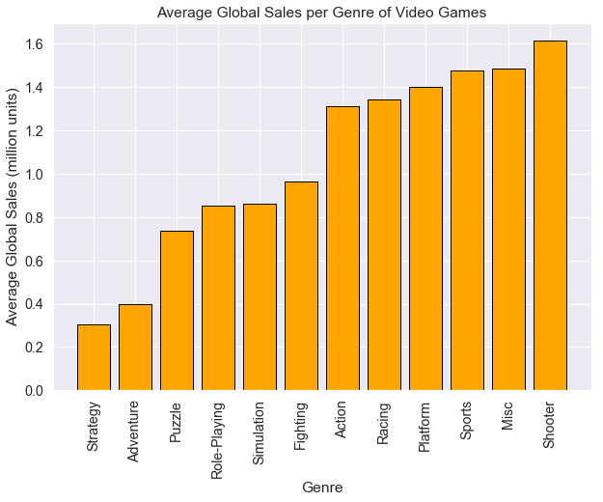
Genre vs Average Global Sales
Average global sales of each genre
Action games have moved to 6th place
Shooters have highest average sales at about 1.6 million units
Notes:
From this plot, it can be seen that action games have moved down from the highest selling genre to the 6th highest. The genre that produces the highest average global sales is Shooter at about 1.6 millions units sold globally.

Slide 15
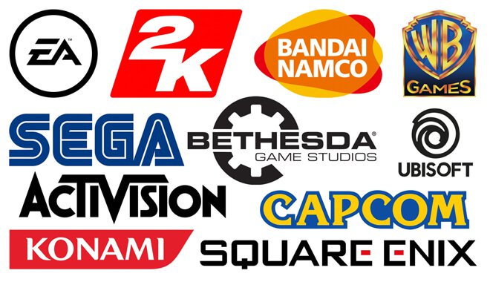
Publishers
https://www.gamedesigning.org/game-development-studios/
Notes:
There are many different publishers in this dataset. Some of them are very big companies and are very well known. There are also a lot of smaller ones that have yet to make a name for themselves. In order to see how the publisher of a video game can affect global sales, the count of video games for each publisher was looked at. Very big publishers have produced a lot more games and therefore will appear many times in the dataset, while smaller ones have produce only a handful of games but are more common.
https://www.gamedesigning.org/game-development-studios/ brands

Slide 16
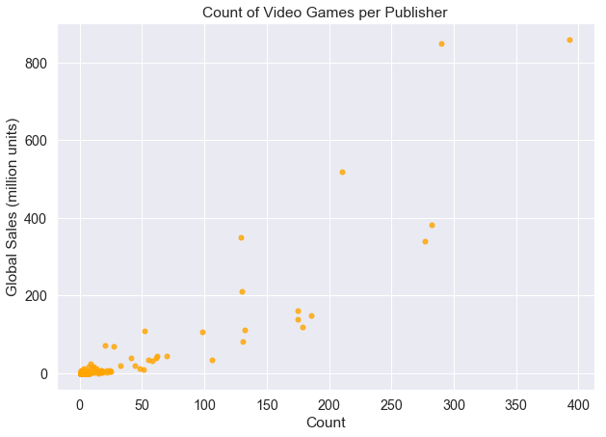
Publisher Game Count vs Global Sales
Count of games per publisher
The more games you make the more money you make!
Many data points at lower left
Log transformation of count and global sales
Notes:
The video games were grouped by publisher and their count of games with an aggregation on the total global sales. It may be obvious, but I think it is useful to be able to visualize this (click). Publisher that have produced more video games have more total global sales. The more games you make, the more money you make. From this plot it looks like there may be positive linear relationship. (click) However, you can see that there are a lot of data points at the bottom left of this plot. (click) In order to visualize these data points a log transformation of both the global sales and count of games was performed, and a linear regression line will be fit to the new, transformed scatter plot (click).

Slide 17
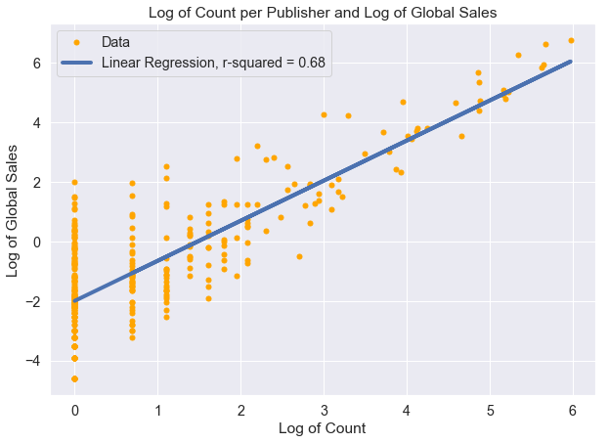
Publisher Game Count vs Global Sales
Log transformation of count and global sales
Fitting a linear regression line
R-squared of 68%
Notes:
This simple linear regression line was able to produce an R-squared value of 0.68, explaining 68% of the variance in the log of global sales. It is clearly seen by the data points, as well as the linear regression line, that there is a strong linear correlation between log of count of games per publisher and the log of global sales.

Slide 18

Machine Learning
https://towardsdatascience.com/machine-learning-for-beginners-d247a9420dab
Notes:
https://towardsdatascience.com/machine-learning-for-beginners-d247a9420dab
One final thing that I would like to present are the results of creating a machine learning model for this dataset in order to predict a game as being high selling or not using scikit-learn.

Slide 19
Classification
Supervised learning for predictions
Need labeled data
Range of global sales values is 0.01-82 million units
High selling = greater than 1 million units
Video games label as either high selling or not
Notes:
(click)The goal of this machine learning model was to perform supervised learning on the dataset of video games in order to make predictions. (click) In order to perform supervised learning, a labeled dataset is needed. (click) Given that the range of possible global sales values of video games is between 0.01-82 million units,(click) it was decided that any video game that sold more than 1 million units would be labeled as high selling. Now that we know how the data was labeled, lets now talk about the machine learning model that was used.

Slide 20

Random Forest Classifier
Ensemble learning method
Majority vote of many decision trees
https://medium.com/@williamkoehrsen/random-forest-simple-explanation-377895a60d2d
Notes:
https://medium.com/@williamkoehrsen/random-forest-simple-explanation-377895a60d2d
The random forest was the classifier of choice for this prediction problem.(click) This is an ensemble learning method (click)that makes use of many different decision trees and takes the majority vote of their results. Next, I would like to talk about the steps taken in order to train and test this classifier.

Slide 21
Steps Taken for Training and Testing
Split the labeled dataset into features variable and a target variable (the label)
Encoded categorical features and the target variable
Split the dataset into training set and a hold-out set
Tuned the hyperparameters of the random forest using sklearn GridSearchCV with the training set
Tested random forest model by fitting on training set and testing on hold-out set
Notes:
(click)The complete labeled dataset was split into a variable that contained various features of a video game and the target variable, the labels of whether or not a video game was high selling. (click) Both the categorical features and the target variable were encoded in order to feed them into the model. (click) The dataset was split into a training set and a hold-out set. (click) The training set was fed into scikit-learn’s GridSearch cross validation model in order to find the best hyperparameters for the random forest. (click) With the model tuned and cross validated, we then tested the model by fitting it on the entire training set and observing how well it predicted the video games of the hold-out set.

Slide 22
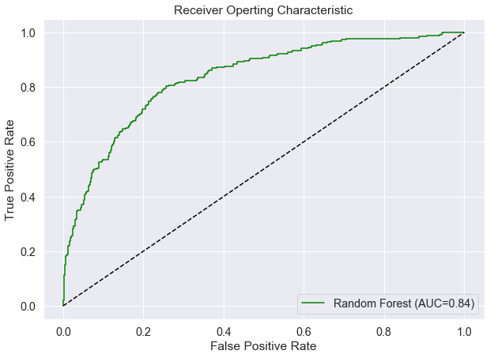
Random Forest Classifier Results
Accuracy = 79%
Precision = 73%
AUC = 84%
Notes:
The three metrics that were focused on were the accuracy score, the precision score, and the AUC obtained from the ROC curve.
The accuracy score tells us that the random forest classifier was able to correctly predict 79% of the hold-out set’s labels. The precision score tells us that 73% of the of video games that were labeled as high selling were indeed high selling. And finally, the AUC is a numerical representation of how well the model performed in regards to the receiver operating characteristic curve and is the total area under the curve.

Slide 23

Key Takeaways
Higher critic scores tend to have higher global sales
Critic score vs log global sales
R-squared of 17%
Shooters had a higher average global sales
Shooter average global sales: ~ 1.6m units
Action average global sales: ~1.3m units
20% of all video games were action
Publishers that make more games make more money
Log of count vs log of global sales
R-squared of 68%
Random Forest Classifier for Prediction
Accuracy of 79%
Precision of 73%
AUC of 84%
https://vsbattles.fandom.com/wiki/Sora_(Kingdom_Hearts)
Notes:
https://vsbattles.fandom.com/wiki/Sora_(Kingdom_Hearts)
Throughout this presentation we have explored a few different features of video games and how they relate to the success in global sales. We saw that video games that had higher critic scores also tend to have higher global sales. (click) (click)(click)We also saw that even though action games had higher total global sales, they had a lower average global sales. This is because they made up about 20% of the dataset.(click) we observed that publishers who made more video games sold more games in total and that it was a pretty clear linear relationship. (click)The linear regression line that had fit the log of count of games and the log of global sales had an R-squared value of about 68%. (click) And finally, we were able to fit a random forest classifier to this dataset that predicted video games as being high selling with an accuracy of 79%, a precision of 73% and an AUC of 84%

Slide 24

Other Avenues to Explore and Areas to Improve
Look into User Scores
Better data cleaning and wrangling
Neural Network
https://www.geek.com/games/11-ways-video-games-can-make-you-a-better-person-1639865/
Notes:
We now come to a close on this presentation of video game sales. I wanted to end with some potential areas that could be improved as well as other avenues that could be explored. (click)We know that there was a statistically significant difference between the Metacritic scores of professional critics and users. What would the results look like if we had focused on user scores instead of critic scores? (click) One area that could have been improved on was the initial data wrangling/cleaning steps. Perhaps a different approach could have been taken there in order to hold onto more of the data and features of a video game. (click) One more thing that could be explored is applying a neural network to this dataset, which has been known to provide good results in terms of prediction and classification.
https://www.geek.com/games/11-ways-video-games-can-make-you-a-better-person-1639865/

Slide 25

https://www.shutterstock.com/video/clip-32553706-retro-game-style-infinite-tunnel-flight-seamless
Notes:
https://www.shutterstock.com/video/clip-32553706-retro-game-style-infinite-tunnel-flight-seamless

